Slide 1
Quantification and Propagation of Uncertainties in Identification of Flame Impulse Response for Thermoacoustic Stability Analysis
Uncertain Input
S. Guo, C. Silva, A. Ghani, W. Polifke
Model
Uncertain Output
ASME Turbo Expo 2018
GT2018-75644

Slide 2
Uncertainty quantification is required to achieve robust thermoacoustic instability prediction
Uncertainty region
Mode location
Acoustic Solver
Unstable
+
Growth Rate
Flame Model
Frequency
Stable
（1）
Flame Model
（2）
Flame Model
Uncertainty Quantification (UQ)

Slide 3
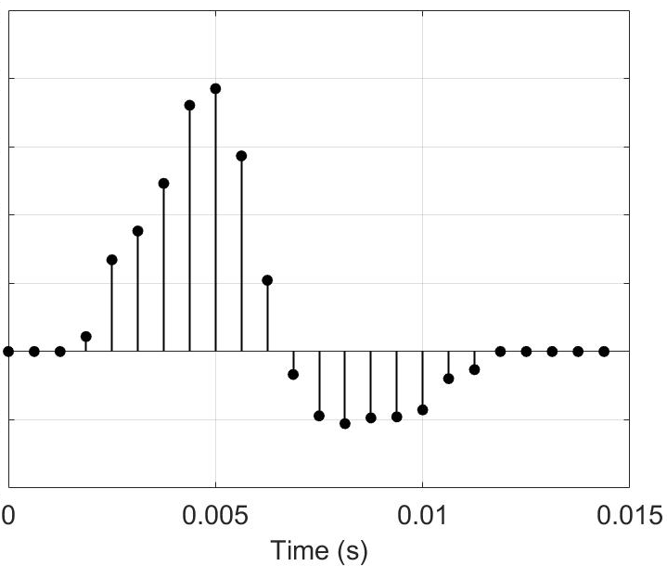
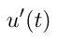
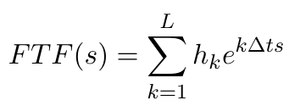
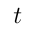
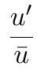
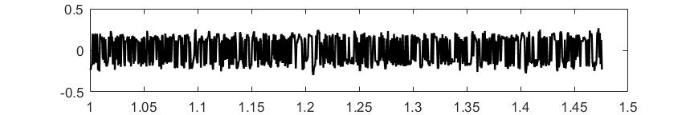
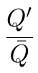
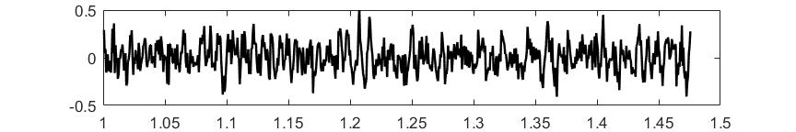
We focus on flame impulse response model in the current study
Impulse Response
Acoustic Solver
+
Flame
Flame Model
0
System Identification

Slide 4
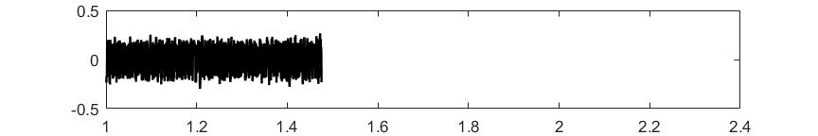
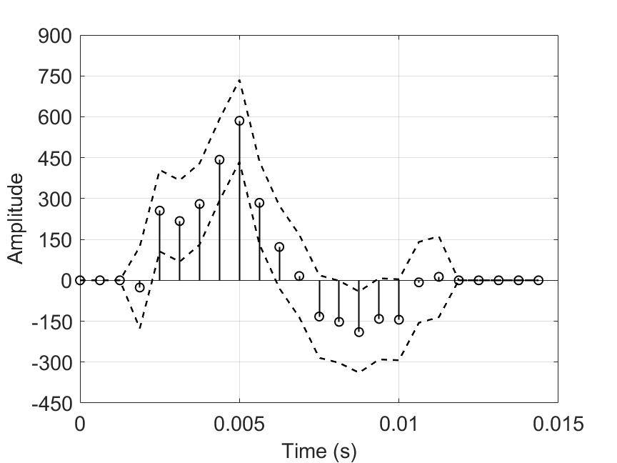
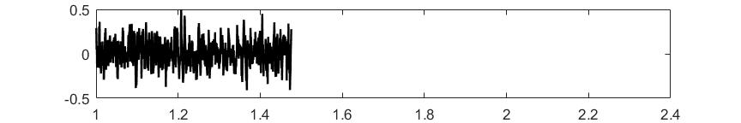

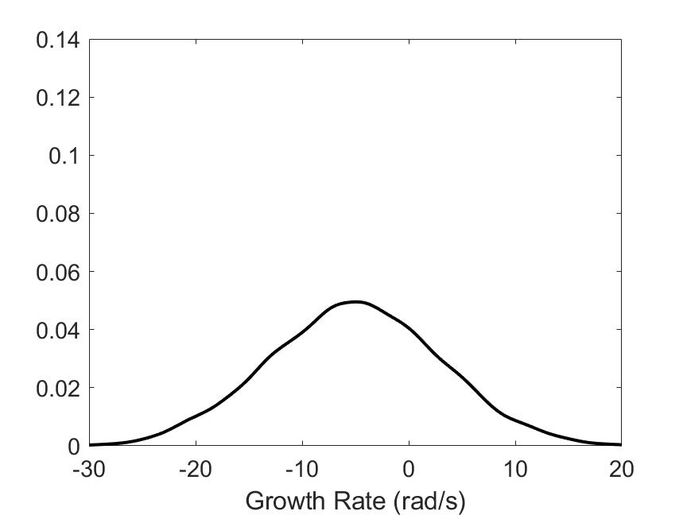
We are interested in the impact of flame impulse response model on thermoacoustic instability prediction
CFD Time Series
Impulse Response
Acoustic
Solver
Growth Rate PDF

Slide 5
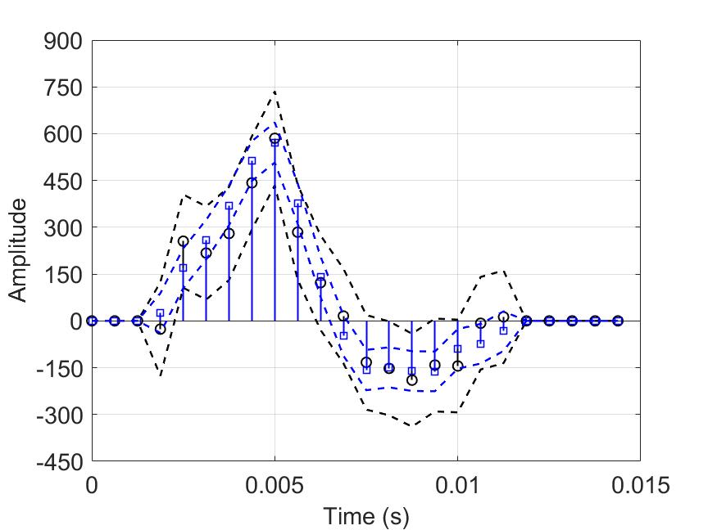
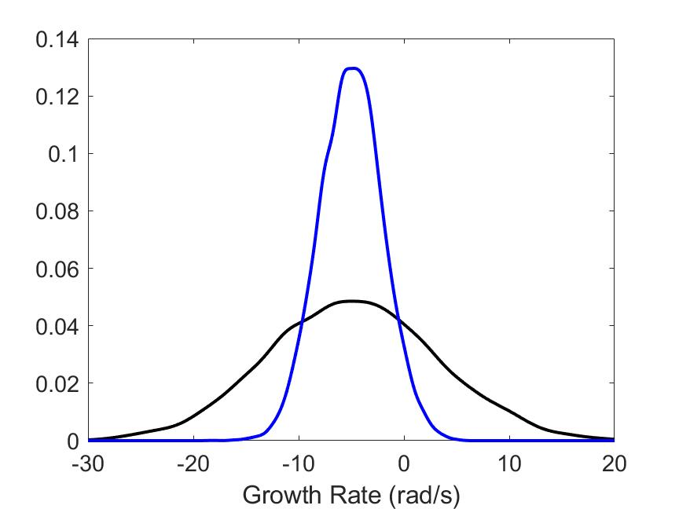
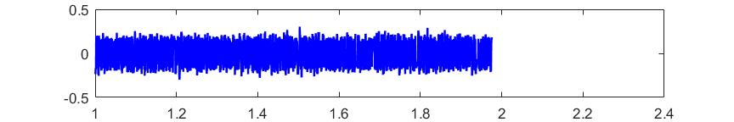
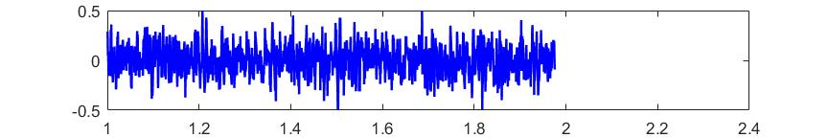
Longer CFD time series yields less uncertain identification of impulse response model as well as growth rate prediction
CFD Time Series
Impulse Response
Growth Rate PDF

Slide 6
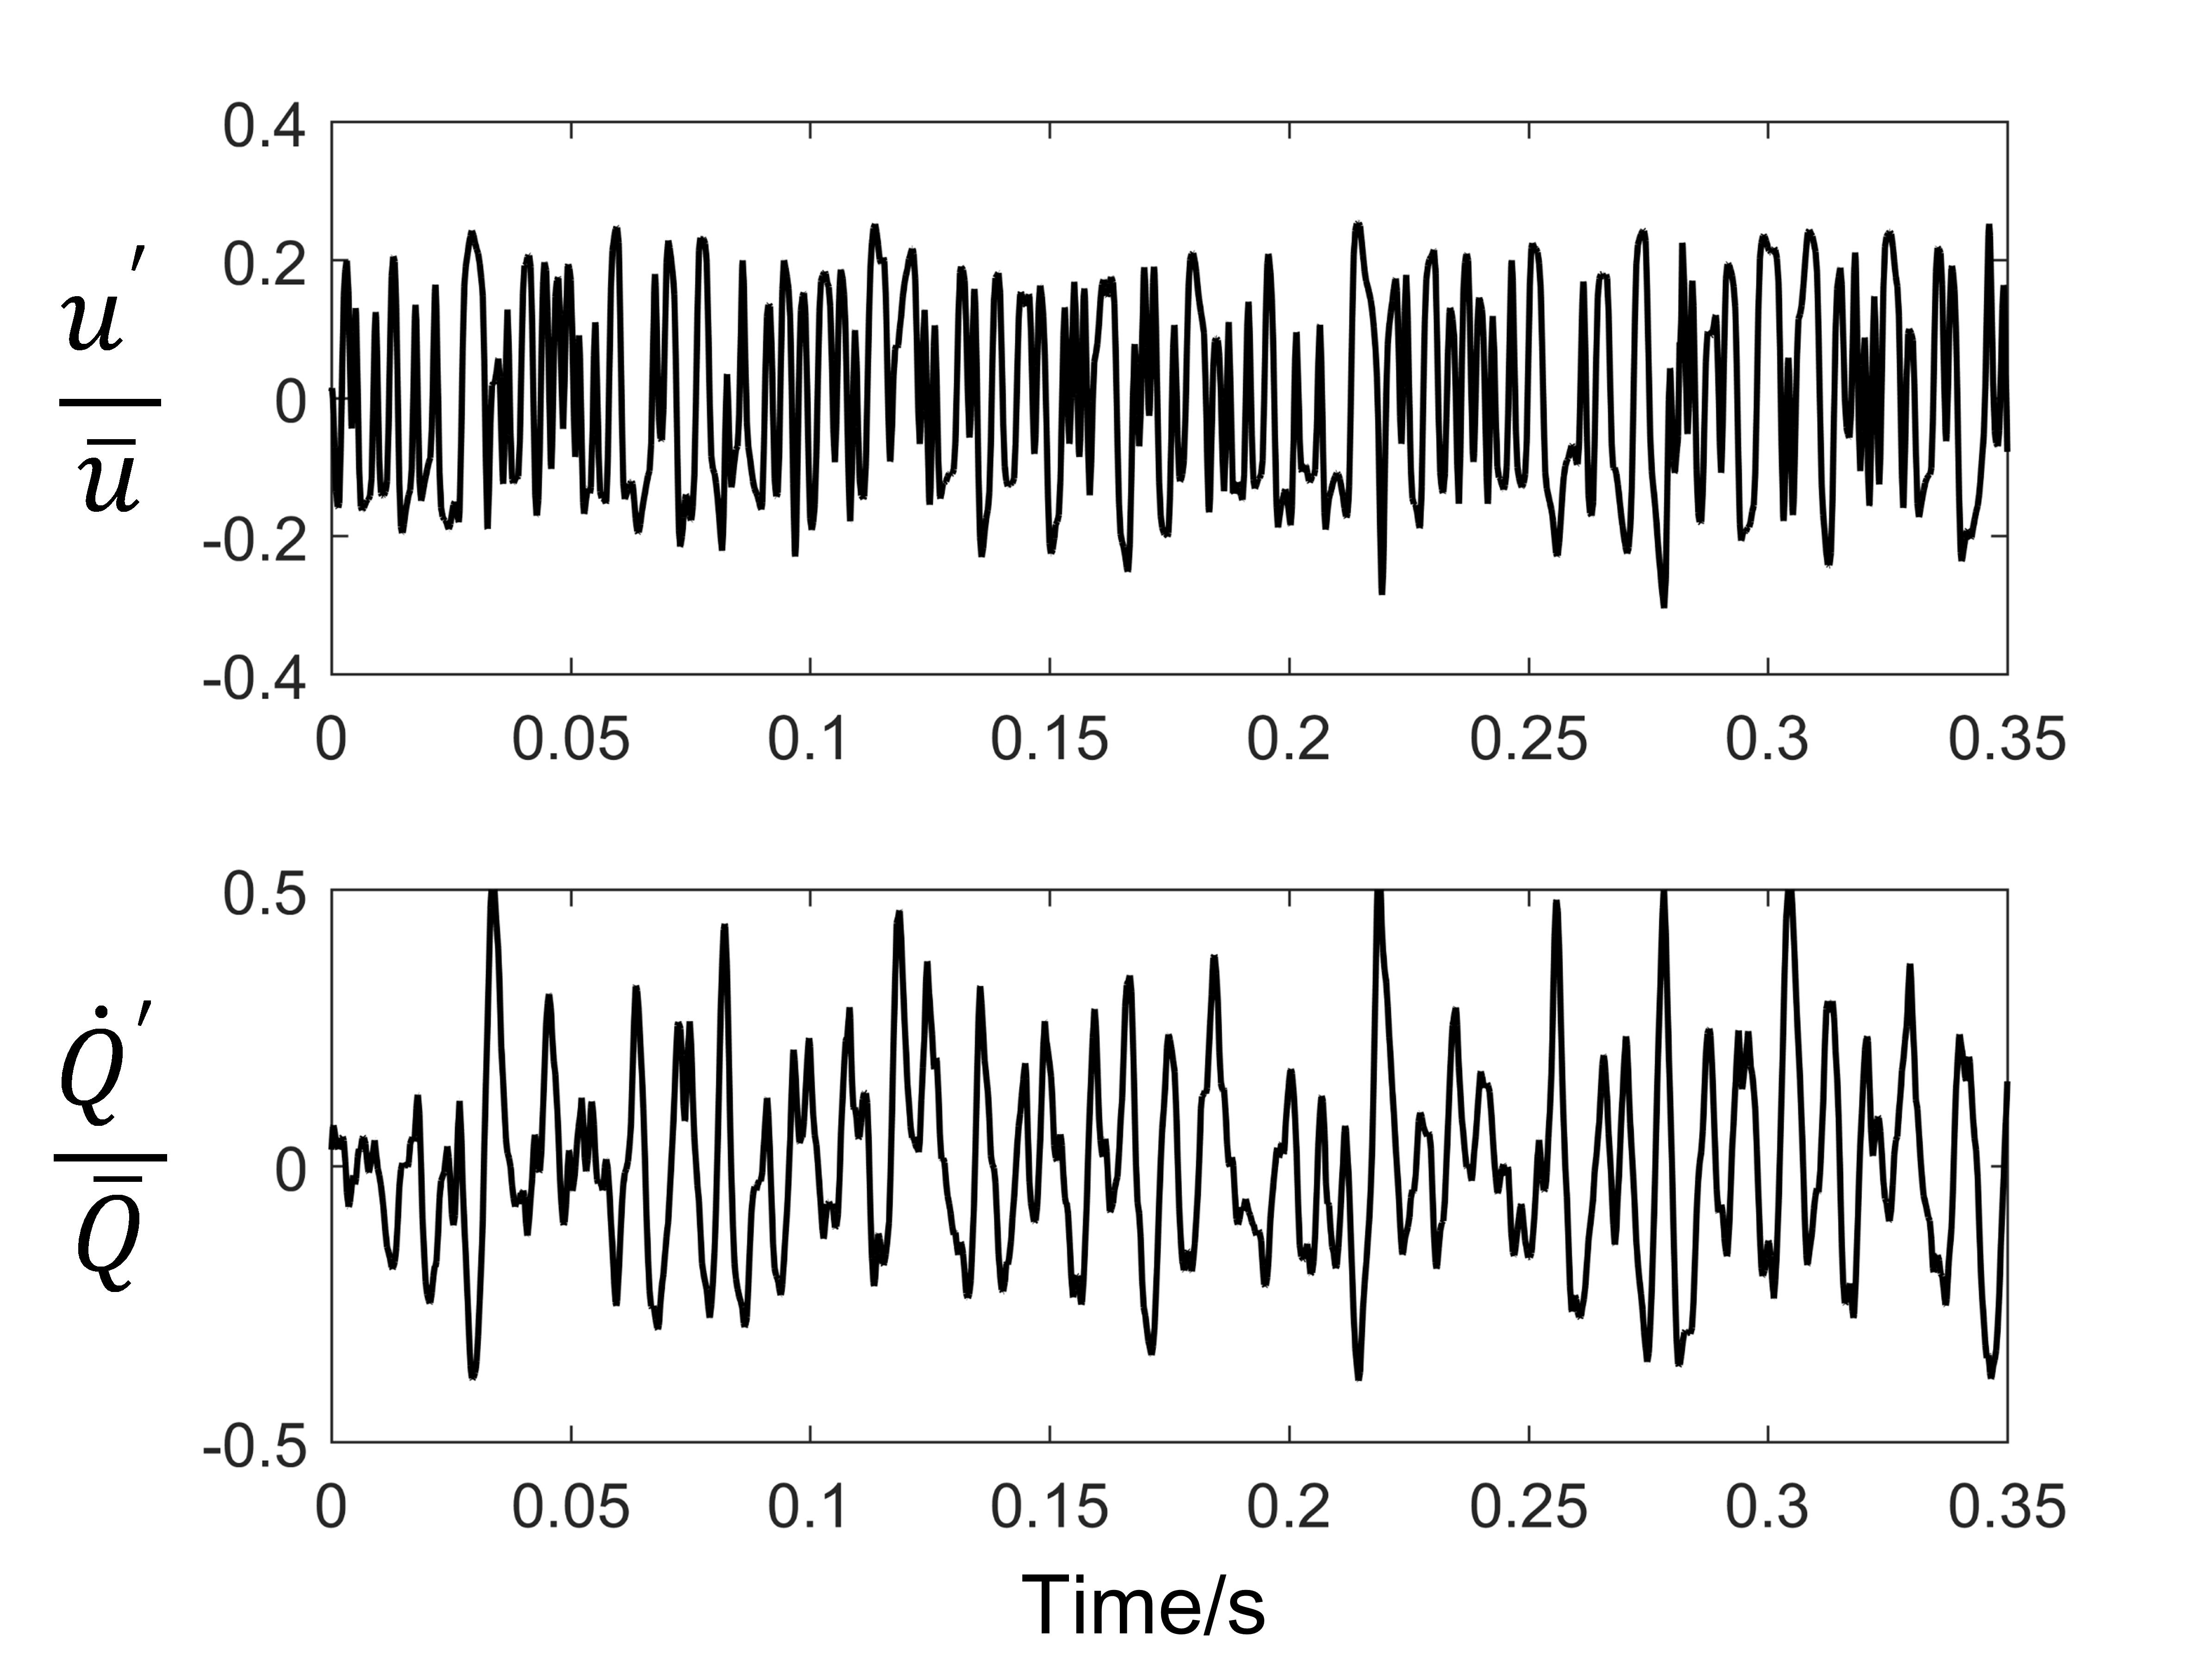
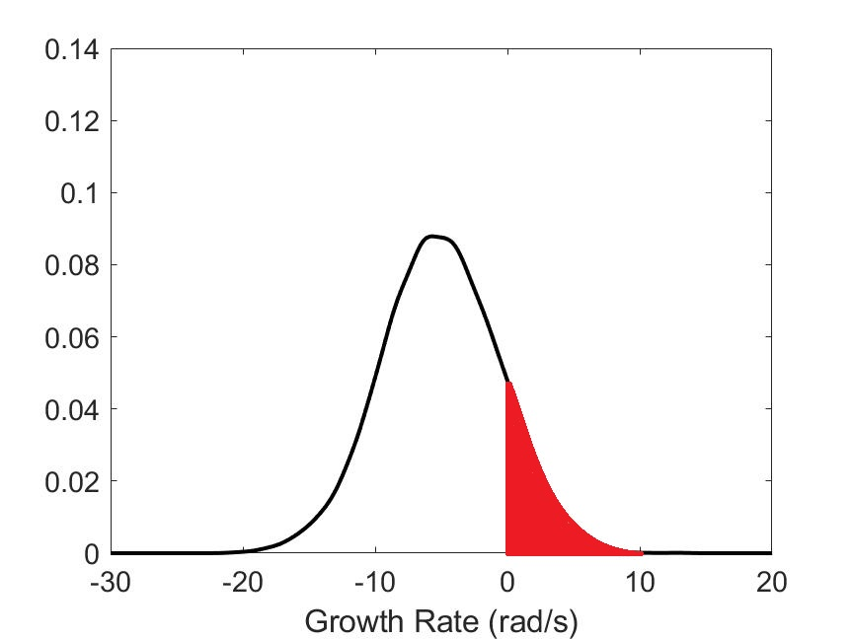
Motivation of our current study
Problem: How to determine the adequate length of CFD time series to achieve a satisfactory uncertainty reduction in growth rate prediction?

Slide 7
Presentation overview
Motivation
Methodology
Thermoacoustic case studies
Results
Conclusions

Slide 8
Methodology – divide and conquer

Slide 9
First we need to solve the problem of efficient forward uncertainty propagation
Problem: How to efficiently propagate uncertainties in flame impulse response model to the growth rate predictions?
Forward Uncertainty Propagation

Slide 10
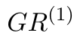
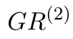
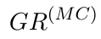
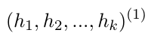
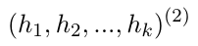
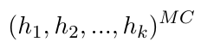
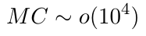
Monte Carlo is an accurate yet very expensive method to achieve forward uncertainty propagation
PDF
FIR Model Uncertainty
Draw
Samples
Acoustic Solver

Slide 11
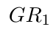
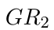
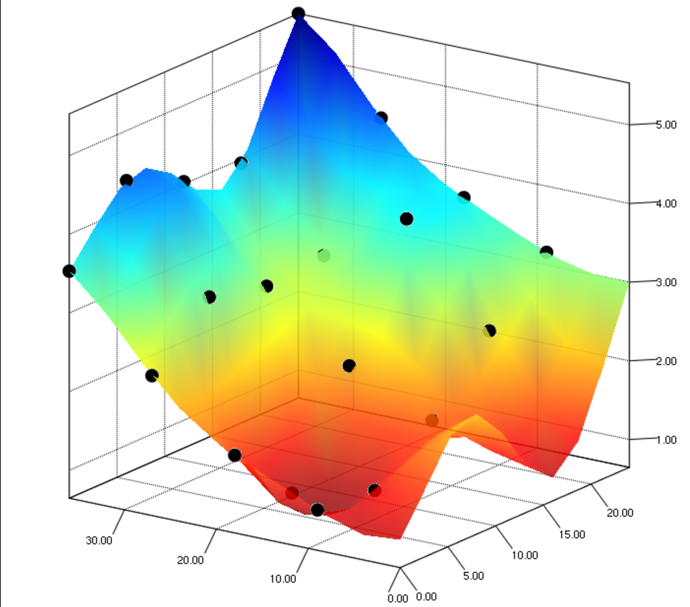
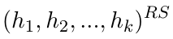
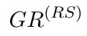
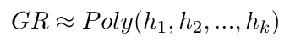
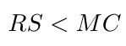
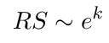
Response Surface Modeling is an alternative for reducing the sample numbers, but it suffers from “Curse of Dimensionality”
PDF
FIR Model Uncertainty
Draw
Samples
Monte Carlo
Acoustic Solver
“Curse of Dimensionality”

Slide 12
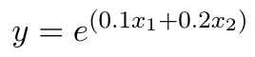
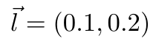
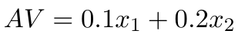
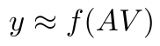
Active Subspace identifies and exploits important directions in input space: Example
Example:
Approximate

Slide 13
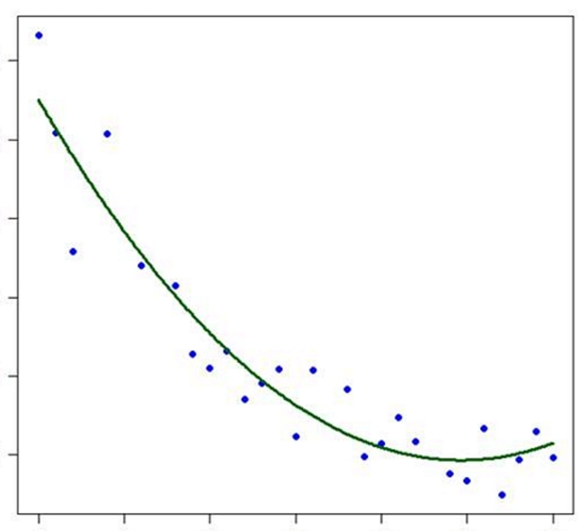
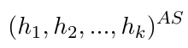
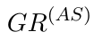
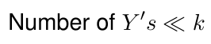
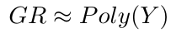
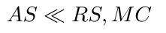
Active Subspace approach offers much more efficient uncertainty propagation by reducing the problem dimensionality
PDF
FIR Model Uncertainty
Draw
Samples
Monte Carlo
Acoustic
Solver
Active Variables (Y’s)

Slide 14
Presentation overview
Motivation
Methodology
Thermoacoustic case studies
Results discussion
Conclusions

Slide 15
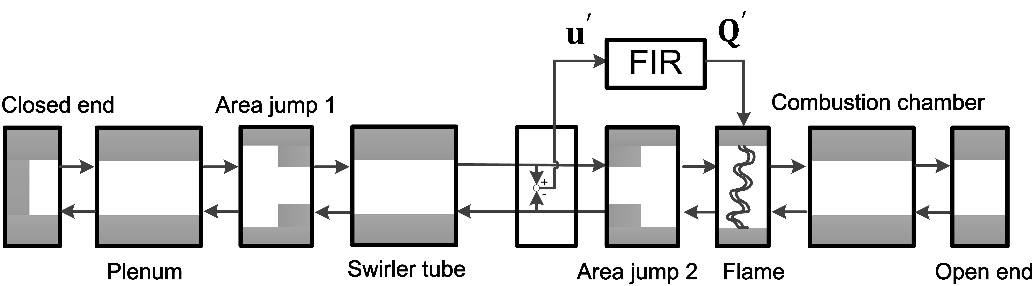
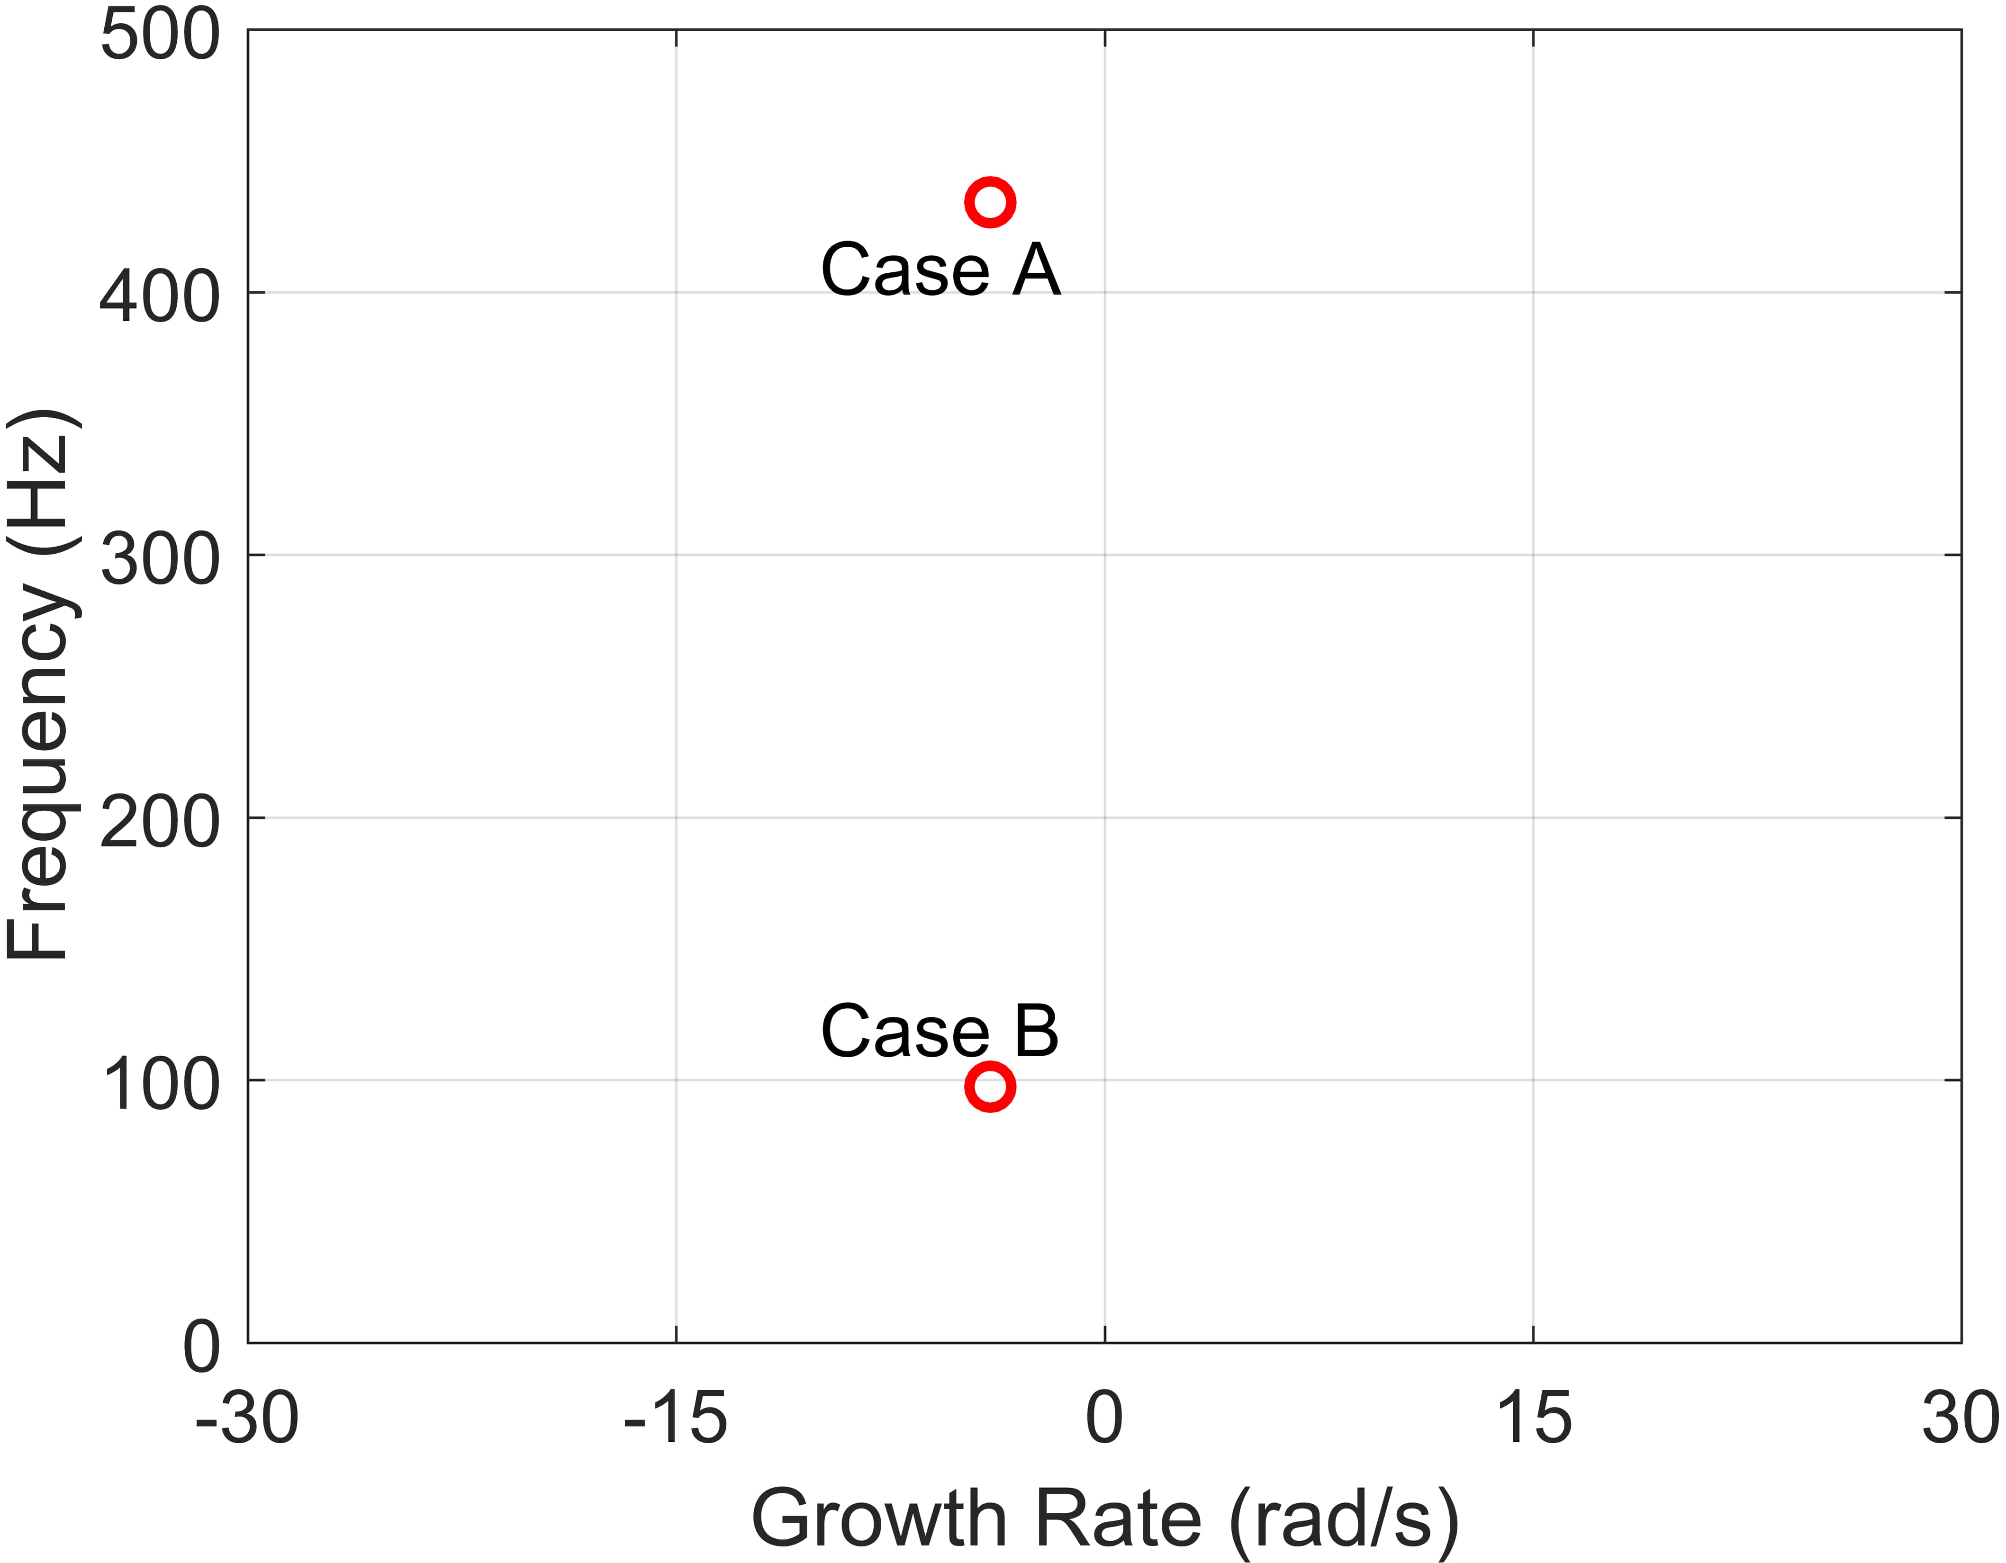
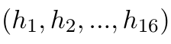
Case studies: acoustic network model, impulse response identification and thermoacoustic mode specification
Stable
Unstable
Multivariate Normal Distribution

Slide 16
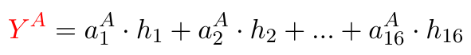
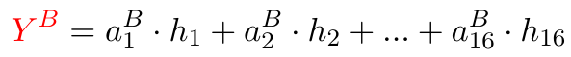
Active Subspace approach identified a single active variable in each case
1
Subspace
Identification
Dimensionality Reduction:
16D
1D

Slide 17
A surrogate model is trained to map from active variable value to growth rate value for each case
1
Subspace
Identification
Dimensionality Reduction:
16D
1D
2
Case A
Case B
Surrogate Model Training

Slide 18
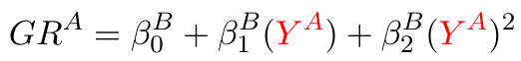
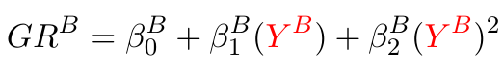
A quadratic function is trained to map from active variable value to growth rate value for each case
1
Subspace
Identification
Case A
Case B
2
Surrogate Model Training

Slide 19






Monte Carlo simulation can be directly applied on the surrogate model to accelerate the UQ analysis
1
Subspace
Identification
2
PDF
Surrogate Model Training
3
UQ
Analysis
Samples
19

Slide 20
Active Subspace replicated the reference Monte Carlo results with 50 times less computational cost
Case A
Case B
Monte Carlo: 20000 acoustic network calculations
Computational Cost:
Active Subspace: 400 acoustic network calculations

Slide 21
Active Subspace is very efficient in quantifying the impact of FIR model uncertainty on thermoacoustic instability prediction
Problem Solved:
How to efficiently propagate uncertainties in flame impulse response model to the growth rate predictions?

Slide 22
The main question we want to address
Problem: How to determine the adequate length of CFD time series to achieve a satisfactory uncertainty reduction in growth rate prediction?

Slide 23


Procedure for estimating the CFD time series length based on Active Subspace approach
CFD data collection
(most available)
System
FIR model & its uncertainty
Identification
Yes
Did Active Subspace before?
CFD advancing
No
No
Monte
Output
Perform
Active Subspace
Satisfied?
Carlo
Yes
Stop CFD

Slide 24



Procedure demonstration
Active
Subspace

Slide 25




Procedure demonstration

Slide 26




Procedure demonstration

Slide 27
Conclusions
1
A procedure to estimate adequate length of CFD time series
Active Subspace offers more efficient UQ analysis
3
One Active Variable is sufficient
2

Slide 28
Back-up Slides

Slide 29



Impulse Response Identification
Velocity fluctuation upstream of the flame
Global heat release rate fluctuation
Convolution
Least Square
Estimations
Estimation Error (Covariance matrix)

Slide 30

Current Impulse Response Model is identified through LES simulations
Test Rig: A turbulent, premixed Swirl Burner
95% CI
1
LES time series
[1] Luis Tay-Wo-Chong et al., 2010 in ASME

Slide 31

Current Acoustic Network Model and its model parameters

Slide 32










Active Subspace Identification
Covariance matrix of gradient vector

Slide 33
Active Subspace Identification
Case A
Case B

Slide 34


Monte Carlo results for case A & B
Case A
Case B

Slide 35

PDF of modal growth rate in terms of cycle increment

Slide 36


Procedure validation
500 ms
1400 ms

Slide 37


Discussion on the single active variable
1. This active variable approximates to first order the casual relationship between variations of the FIR model coefficients and variations of the model growth rate
2. It is possible to analytically derive the linear combination coefficients in active variable expression

Slide 38
Discussion on the single active variable
3. This first-order approximation fails when uncertainties in impulse response model is to large, which is not allowed in real application of flame impulse response model

Slide 39




Discussion on the single active variable (phasor plot demo)

